Slide 1
Welcome
To My Presentation

Slide 2
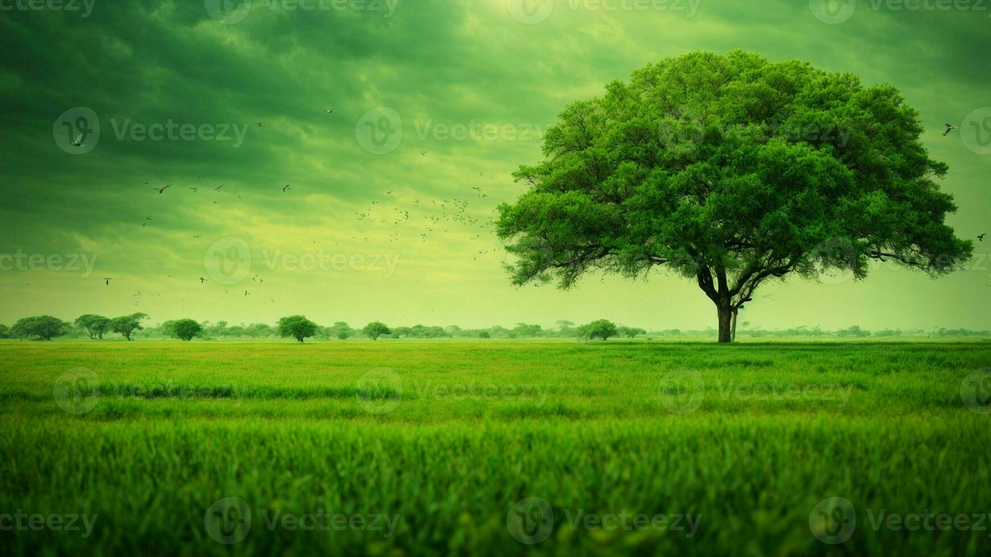
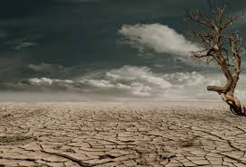
Climate Change

Slide 3
Definition:
Causes of Climate Change:
Generating powers
Manufacturing goods
Cutting down forests
Use of huge private transportation
Consuming too much
Greenhouse gas emission
Climate change refers to long-term shifts in temperatures and weather patterns. Such shifts can be natural, due to changes in the sun’s activity or large volcanic eruptions. But since the 1800s, human activities have been the main driver of climate change, primarily due to the burning of fossil fuels like coal, oil and gas.

Slide 4
Consequences:
Rising sea level
Heatwaves
Drought
Frequent flood and storms
Disruption to agriculture and water scarcity
Loss of bio-diversity etc.

Slide 5
Thank You

